Slide 1

AMRITA SCHOOL OF ARTIFICIAL INTELLIGENCE, BENGALURU
B. Tech in Artificial Intelligence and Data Science (AID)
Fourth Semester, Section F, Academic Year: 2024-25
OPERATING SYSTEM - (23AID213)
END-TERM PROJECT REPORT
On
Designing a Virtual Memory Manager with demand
paging support
Presented by Group No. 21
Valluri Veera Gangadhara Sai Teja(BL.EN.U4AID23062)
Vecha Devi Sri Prasad (BL.EN.U4AID23057)
Mentor :Ms. Pooja Gowda

Slide 2
Contents
Introduction
Motivation
Literature Survey
Problem Statement
How OS can solve the problem
Project Objectives
Methodology
Results
Conclusion
Future Works
References

Slide 3
Introduction
In this project we’ll take a close look at how virtual memory management works and explore the intricate details of key operating system concepts like process scheduling, concurrency control, demand paging, and memory allocation
Our main goal is to optimize resource usage so that every user gets their fair share of computing power based on their specific needs. We’ll dig deep into the complexities of page tables, uncover the inner workings of demand paging, and embrace the principles of EAT to ensure operational efficiency.
Enhanced Experience: Offer personalized advice and repayment flexibility.

Slide 4
Motivation
Efficient Resource Allocation: To manage memory effectively in multi-user environments by implementing demand paging and optimized memory access.
Integration of OS Concepts: To simulate real-world scenarios using key operating system principles like process scheduling, concurrency control, and page replacement.
Educational Value: To provide a hands-on, GUI-based tool that helps students and developers better understand and visualize virtual memory management.

Slide 5
Study Name | Year | What They Did Not Do | What We Did | Key Takeaways | OS Topics
Virtual Memory – Peter J. Denning | 1970 | Avoided static/manual memory allocation | Proposed virtual memory using paging/segmentation | Enables efficient, modular memory use; risk of thrashing and overhead if unmanaged | Virtual memory, paging, segmentation
Virtual Memory Management in Chorus | 1989 | Avoided hardware-specific memory management | Designed hardware-independent VM layer for distributed OS | Achieved portability and efficient memory operations | Paged memory, kernel abstraction
Demand Paging in Perspective | 1968 | Ignored program structure’s role in memory usage | Optimized demand paging through program/OS design | Locality and structure drastically affect paging efficiency | Demand paging, scheduling, modularity
Concurrency Control in Transactional Process Management | 1999 | Didn’t unify concurrency and recovery in processes | Integrated both in a flexible model with compensation/retries | Better support for workflows, partial failures, concurrent execution | Concurrency, transactional processes

Slide 6
Study Name | Year | What They Did Not Do | What We Did | Key Takeaways | OS Topics
Process Control and Scheduling for Multiprogrammed SMPs | 1989 | Didn’t adapt number of processes to available CPUs | Dynamically adjusted runnable processes via a central server | Boosted performance up to 2× by reducing contention and context switching | Multiprocessor scheduling, threads
Translation-Lookaside Buffer Consistency | 1990 | Relied on hardware consistency mechanisms | Proposed 9 software/hardware solutions for TLB consistency | Described trade-offs in scalability, overhead, and memory sharing | TLB, virtual memory, cache consistency
Reducing Everyday Memory and Planning Problems by Means of a Paging System | 2001 | Previous approaches didn’t support people with executive/memory deficits well using complex external aids. | Used a simple alphanumeric paging system to deliver timed reminders for daily tasks in brain injury patients. | Pager significantly improved task success rates (from ~47% to ~76%); 73% retained gains after pager was removed. | Cognitive assistive systems
Competitive Paging Algorithms | 1991 | Earlier paging strategies lacked optimal bounds for randomized online algorithms and didn’t combine strategies. | Introduced the marking algorithm (2H<sub>k</sub>-competitive), and a method to combine multiple algorithms. | Marking algorithm is near-optimal; no randomized algorithm can beat H<sub>k</sub>; combining strategies is viable. | Paging, Online Algorithms, Caching

Slide 7
Study Name | Year | What They Did Not Do | What We Did | Key Takeaways | OS Topics
A Survey of Memory Management Techniques in Multiprogramming Systems | 1974 | No experimental validation, real-world implementation, or consideration of modern systems. | Extended the study with modern techniques, experiments, implementation case studies, and security analysis. | Trade-offs exist between efficiency, flexibility, and security; memory management directly affects performance and scalability. | Paging, segmentation, virtual memory, protection, sharing, memory allocation, and modern security implications
Fine-grain Quantitative Analysis of Demand Paging in Unified Virtual Memory | 2024 | Didn’t provide fine-grain cost analysis of UVM. No breakdown of individual paging tasks like fault servicing or batch handling. | Measured cost of UVM tasks (faults, replay, etc.). Extended to multi-GPU systems and interconnects. Analyzed prefetching and oversubscription effects. | Page fault servicing is the most expensive step. Host OS causes high overhead. GPU-GPU paging is faster. | Virtual Memory Demand Paging GPU Memory Management OS Driver Interaction Multi-GPU Communication

Slide 8
Problem Statement
Modern multi-user systems, such as web servers, face challenges in efficiently managing memory resources while serving multiple concurrent users.
Traditional memory allocation methods may lead to inefficient resource usage, high latency, and poor scalability. There is a need for a system that can dynamically allocate memory, load only the necessary data into physical memory, and manage concurrent access without conflict.
This project aims to address these challenges by implementing a virtual memory manager using demand paging, effective access time calculation, and optimal page replacement strategies to ensure efficient and fair memory utilization.

Slide 9
How OS can solve the problem
Demand Paging: Loads only required pages into physical memory, reducing memory wastage and improving efficiency.
Process Scheduling & Concurrency Control: Ensures fair CPU and memory access among multiple users without conflict.
Page Tables & TLB (Translation Lookaside Buffer): Enable fast and efficient translation of virtual addresses to physical addresses, minimizing access time.

Slide 10
Project Objectives
Simulate Virtual Memory Management using Java with a graphical user interface (GUI) to demonstrate key OS concepts.
Implement Demand Paging to load pages into memory only when needed, optimizing memory usage.
Manage Page Tables and TLB for efficient address translation and memory access.
Calculate Effective Access Time (EAT) based on TLB hit ratio, memory access time, and page lookup.
Support Optimal Page Replacement by allowing simulation with user-defined reference strings and frame limits.

Slide 11
Methodology
User Process Generation
Simulate multiple user processes with unique IDs and varying memory requirements.
Logical Address Space Creation
Divide each process's memory into fixed-size pages; generate logical addresses for memory accesses.
Paging Mechanism Simulation
Physical memory is divided into equal-sized frames. Each process maintains a page table mapping pages to frames.
Page Allocation & Replacement
Allocate pages to free frames. When memory is full, simulate page replacement using algorithms like Optimal Replacement.
Address Translation
Translate logical addresses to physical addresses via page tables. Handle page faults dynamically.

Slide 12
Methodology
Translation Lookaside Buffer (TLB) Integration
Use a TLB to cache recent page table entries and speed up address translation. Simulate TLB hit/miss behavior.
Effective Access Time (EAT) Calculation
Calculate EAT using:
EAT = (α × (E + m)) + ((1 - α) × (E + 2m)),
where α = TLB hit ratio, E = TLB search time, m = memory access time.
Multi-User Memory Management
Supports multiple virtual memory instances, ensuring fair and isolated memory management across users.
Simulation and Debugging
Provides real-time simulation of memory operations and GUI-based feedback for easier debugging and learning.

Slide 13
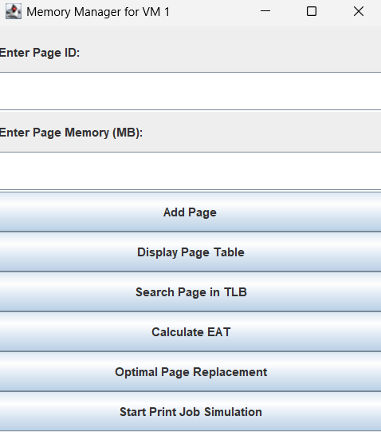
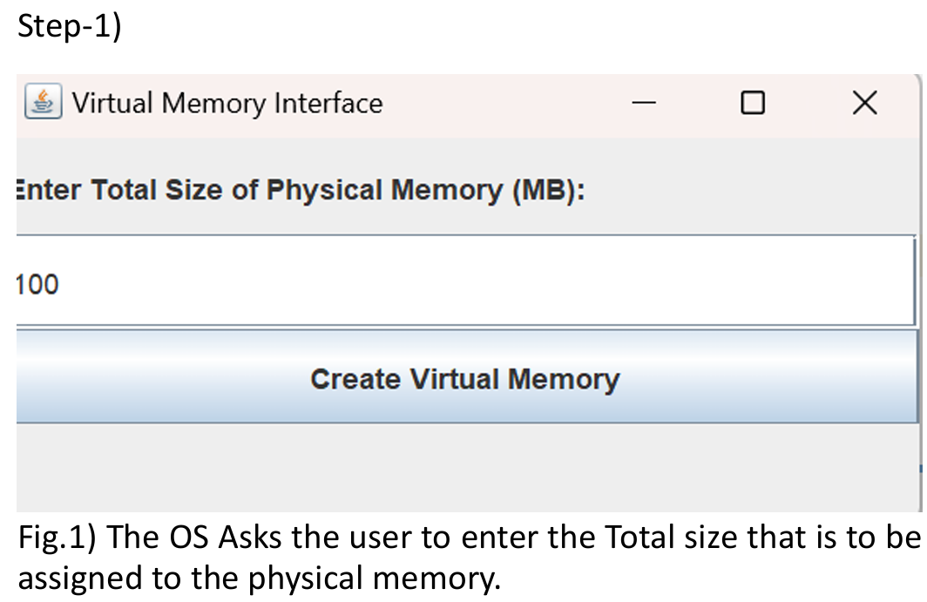
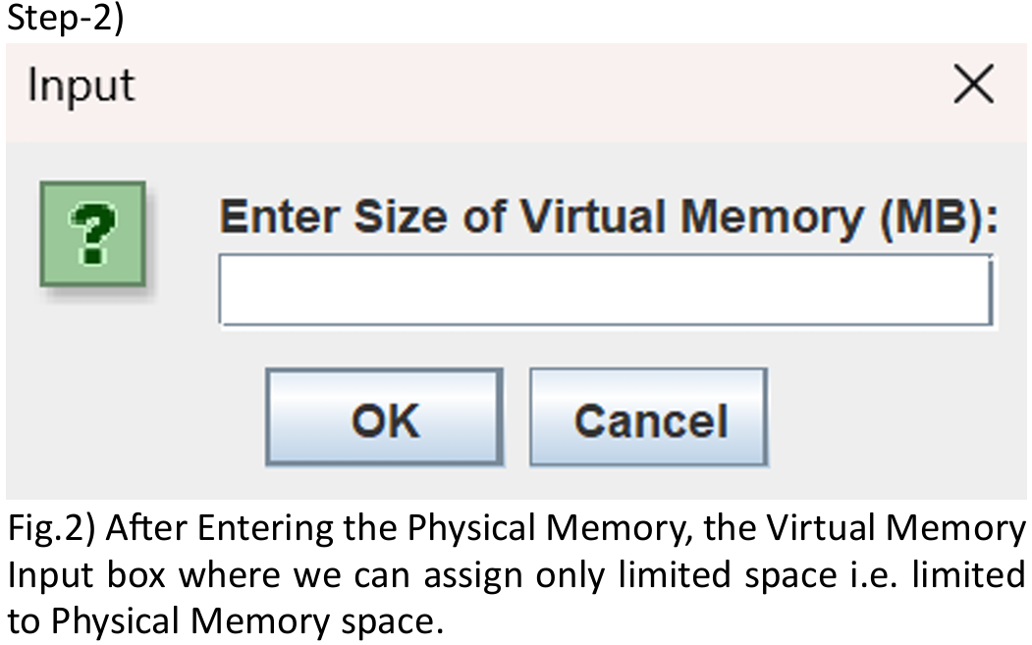
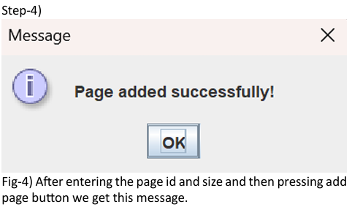
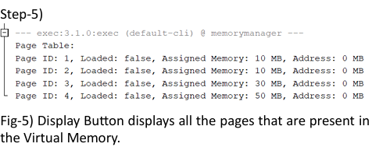
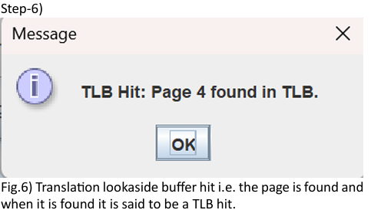
Result and Demo

Slide 14
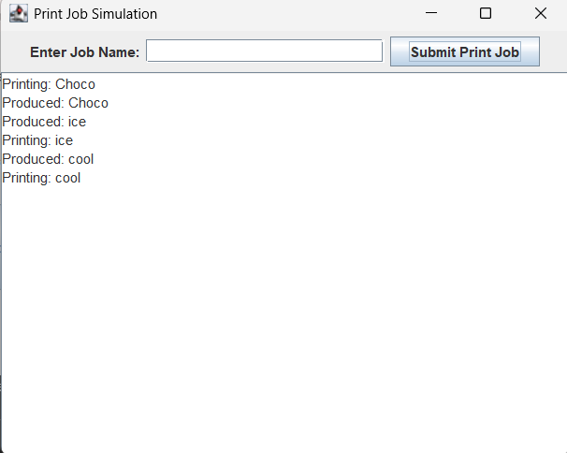
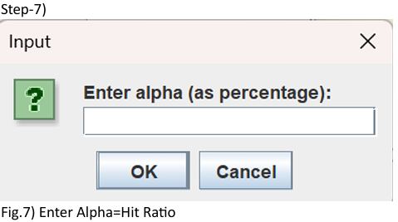
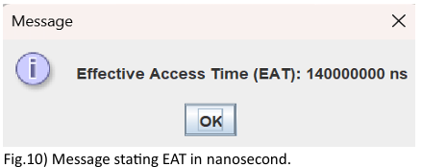
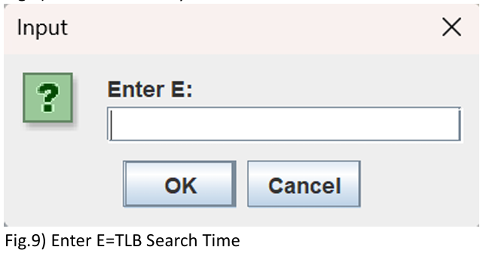
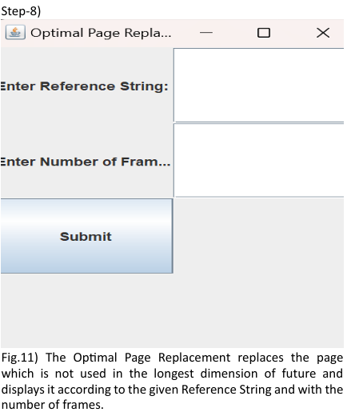
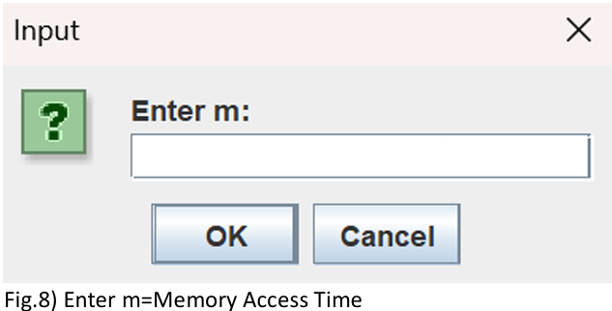
Result and Demo

Slide 15
Conclusion
This project successfully simulates a virtual memory management system using paging and demand paging techniques, providing a realistic understanding of how operating systems handle memory in multi-user environments.
The implementation features a graphical interface built with Java Swing in NetBeans, allowing users to interact with memory components such as the page table, TLB, and effective access time.
The system demonstrates core OS concepts like address translation, TLB caching, page faults, and optimal page replacement, highlighting the performance trade-offs in memory management.
The use of object-oriented design ensures modular, maintainable, and scalable code.

Slide 16
Future Work
Enhanced Page Replacement Algorithms: Add support for LRU, FIFO, or Clock algorithms to compare performance across strategies.
Segmentation Support: Extend the system to simulate segmentation or segmentation with paging for more complex memory management.
Error Handling and Validation: Improve input validation and exception handling for a more robust user experience.
Web-based Interface: Migrate the system to a web-based platform for broader accessibility and interactive learning

Slide 17
References
[1] A Survey of Memory Management Techniques in Multiprogramming Systems (1974) by Gerald J. Popek and Robert P. Goldberg(https://doi.org/10.23860/thesis-armitage william-1974)
[2]Operating System Concepts: Essentials, Inc. (2018) by Abraham Silberschatz, Peter B. Galvin, and Greg Gagne(https://doi.org/10.14778/3415478.3415571)
[3]Computer Systems: A Programmer's Perspective (2009) by Randal Bryant and David Warren Arnold(https://thuvienso.hoasen.edu.vn/handle/123456789/8621)
[4]The VM/370 System Primer-a study of multiplicity and usefulness by L. H. Seawright and R. A. MacKinnon

Slide 18
Thank you

